Slide 1
To build a v-profile project.
Submitted in the partial fulfillment for the award of the degree of
BACHELOR OF ENGINEERING
IN
COMPUTER SCIENCE WITH SPECIALIZATION IN
DEVOPS
Submitted by:
VISHWACHI PANDEY 22BDO10012
ANAND TIWARI 22BDO10022
SHIVAM 22BDO10025
Under the Supervision of:
ANKUR GUPTA
Department of AIT-CSE
DISCOVER . LEARN . EMPOWER

Slide 2
Outline
Introduction to Project
Problem Formulation
Objectives of the work
Methodology used
Results and Outputs
Conclusion
Future Scope
References

Slide 3
Introduction to Project
Challenges Identified:
Complexity of local setups.
Non-reproducibility of environments.
Limited comfort in implementing real changes.
Inefficient R&D capabilities.
Reliance on manual configurations.
Workflow Revolution:
Introduction of automated, repeatable, and standardized local setup.
Utilization of tools: Vagrant, VirtualBox, Git Bash, and Visual Studio Code (VS Code) .
Streamlining the local development environment.

Slide 4
Comprehensive Multi-Tier Architecture:
Incorporation of technologies: LAMP, NGINX, Tomcat, RabbitMQ, Memcached, MySQL, and WordPress.
Platform for seamless handling of server-side scripting, database management, web server configurations, and component integration.
Empowering Developers for R&D:
Establishment of an automated, code-driven local environment.
Facilitation of isolated test environments for thorough testing before production implementation.
Adoption of version control with Git for enhanced collaboration.

Slide 5
Problem Formulation
Complexity in Local Setup:
Problem: Intricate nature leading to configuration challenges and time consumption during setup.
Objective: Simplify local setup with automation, rWeducing learning curve and ensuring straightforward component configuration.
Non-Reproducibility of Environments:
Problem: Inconsistencies across machines hinder collaboration and maintainability.
Objective: Implement automation for reproducible development environments, ensuring consistency across diverse machines.

Slide 6
Discomfort in Making Real Changes:
Problem: Lack of a reliable local testing environment causes hesitation and a lack of confidence in making real-time modifications.
Objective: Establish a secure local testing environment for confident real-time changes, enabling thorough testing before production deployment.
Inefficiencies in Research and Development (R&D):
Problem: Current environment lacks support for efficient R&D activities, hindering meaningful experiments.
Objective: Enhance R&D capabilities by providing tools for creating isolated test environments, fostering experimentation and innovation in a controlled setting.

Slide 7
Objectives of the Work
Streamlining Setup and Accessibility:
Objective: Simplify the local development environment setup, reducing complexities and time for developers, making it more accessible.
Ensuring Reproducibility and Consistency:
Objective: Implement automation for reproducible development environments, ensuring consistency across different machines and eliminating variations in setups.
Creating a Secure and Confident Environment:
Objective: Establish a secure and comfortable local testing environment, allowing developers to make real changes confidently, with thorough testing before production deployment.

Slide 8
Methodology used
Analysis and Requirement Gathering:
Conduct a comprehensive analysis of the current development environment.
Gather requirements from stakeholders to understand needs and expectations.
Technology Stack Selection:
Evaluate and select appropriate technologies and tools for automation. Choose scripting languages and configuration management tools based on compatibility and scalability.
Infrastructure as Code (IaC) Implementation:
Implement IaC principles using tools like Vagrant and VirtualBox for automated environment provisioning.
Create scripts defining infrastructure components for consistency across machines.

Slide 9
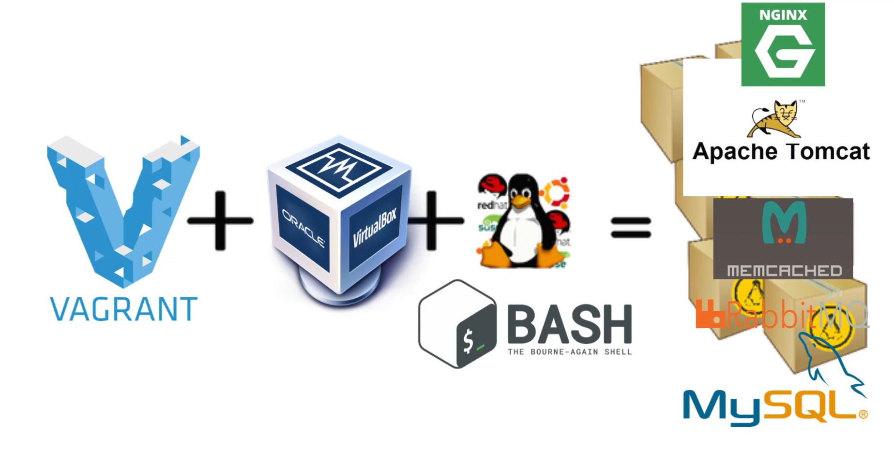
Tools used:

Slide 10
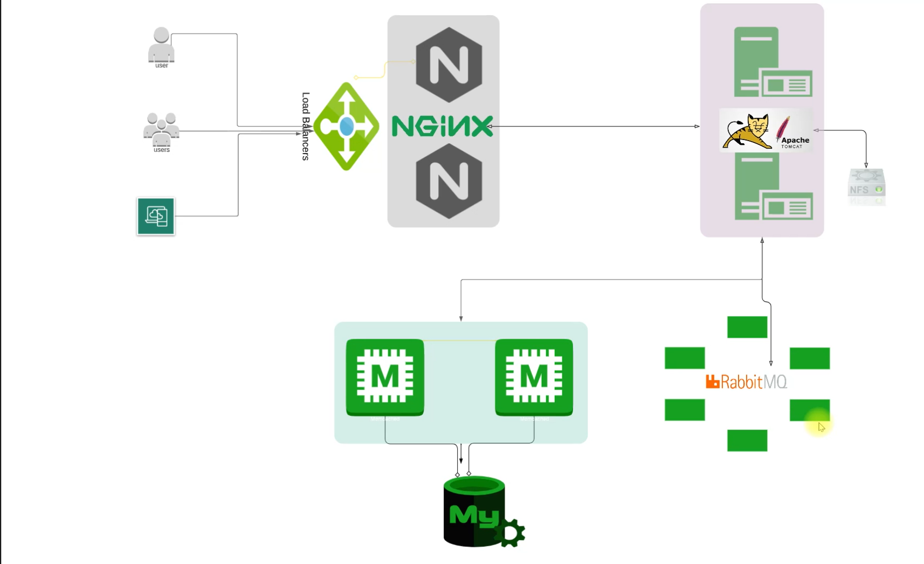
Services workflow:

Slide 11
Configuration Management:
Implement configuration management tools for automating setup and configuration of components.
Use tools like Ansible or Puppet for enforcing consistent configurations.
Local Testing Environment Setup:
Establish a local testing environment mirroring production setup for controlled testing.
Integrate version control, continuous integration, and automated testing tools.
Documentation and Training:
Document automated setup processes with step-by-step guides.
Provide training sessions to familiarize the development team with the new automated environment.

Slide 12
Results and Outputs
Efficient Local Setup:
Developers benefit from a simplified setup, reducing the time and effort required to configure components and enabling quick initiation of coding and testing.
Consistent Environments:
Implementation of IaC principles ensures the reproducibility of development environments, eliminating variations across machines and providing a uniform platform for all team members.
Confident Real Changes:
Access to a secure local testing environment empowers developers to make real changes confidently, reducing the risk of errors and improving the quality of deployed code.

Slide 13
Enhanced R&D Capabilities:
Introduction of tools for creating isolated test environments facilitates efficient research and development activities, encouraging innovation and experimentation.
Reduced Manual Configurations:
Automated setup minimizes reliance on manual configurations, ensuring standardization and facilitating a smoother onboarding process for new developers.
Improved Collaboration and Workflow:
Integration of the automated setup into the existing development workflow fosters collaboration, allowing developers to focus on coding and testing without disruptions, leading to improved productivity.

Slide 14
Conclusion
Automated Setup with Key Tools:
Utilization of Oracle VM VirtualBox, Vagrant, Git Bash, and VS Code to automate VM setup locally, streamlining the local development environment and enhancing user comfort.
Comprehensive Development Environment:
Integration of crucial components like NGINX, TOMCAT, RABBITMQ, MEMCACHED, and MYSQL, providing a comprehensive platform for research and development activities on laptops or desktops.
Efficient Architecture for Development and Experimentation:
Architectural focus on Vagrant, VirtualBox, and Git Bash orchestrating an efficient environment, ensuring repeatability, and facilitating experimentation in multi-tier web application development.

Slide 15
Future Scope
Enhanced Service Support: Extend support for additional web development services like Redis, MongoDB, Elasticsearch, increasing the project's versatileity and adaptability.
Containerization Integration: Incorporate Docker or other containerization technologies to encapsulate each service, offering better isolation, portability, and scalability for the project setup.
Configuration Management Enhancement: Implement advanced configuration management tools (e.g., Ansible, Puppet, Chef) for further automating setup and configuration processes, enhancing maintainability.
User Environment Customization: Allow users to customize the environment, providing options for selecting service versions, configuring networking settings, and specifying resource allocations to meet specific project requirements.
CI/CD Pipeline Integration: Integrate the project setup with continuous integration and deployment pipelines, automating the deployment process and ensuring seamless transitions across development, testing, and production environments.

